Slide 1
Rate Card flow in Right Price 2.0 Application
20th February,2019

Slide 2
Table of Contents
Introduction:
Right Price 2.0 portal is an enhanced version of the existing Right Price application with new, improvised additional features. The purpose or intent of the document is to capture to be functionality and overall flow of the application. The intent of new portal is to create an application with better User interface, maintainable application with performance improvements.
Table of Contents:
The document is exclusively meant for Atos Syntel Employees having valid Syntel credentials belonging to either Delivery, GFT, BU Head, CDO, CEO Delivery Head or CEO Office.

Slide 3
Table of Contents
Below are the screens available under Rate card Menu:
Rate Card Creation – Details
Role Selection
Role Utilization And Rates
Summary
Finalize Rate Card

Slide 4
Table of Contents
Rate cards module shall allow the Delivery team to create new Rate Cards for all those customers, which the logged in user has access to and belonging to the logged in user’s Vertical. Below are the several combinations in which the Rate Cards can be created:-
Automatic
Manual
Hybrid
KPO

Slide 5
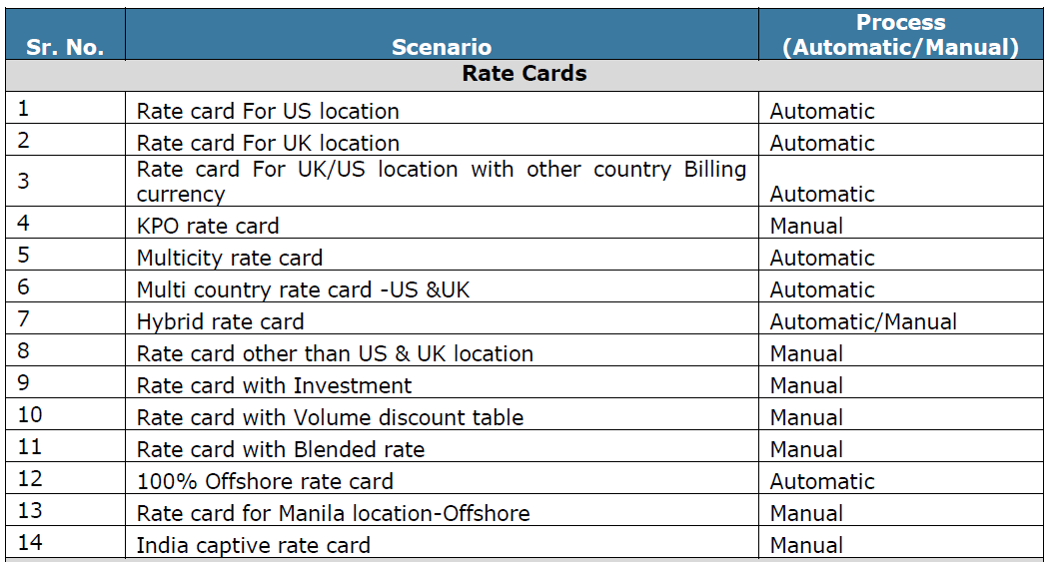
Table of Contents

Slide 6
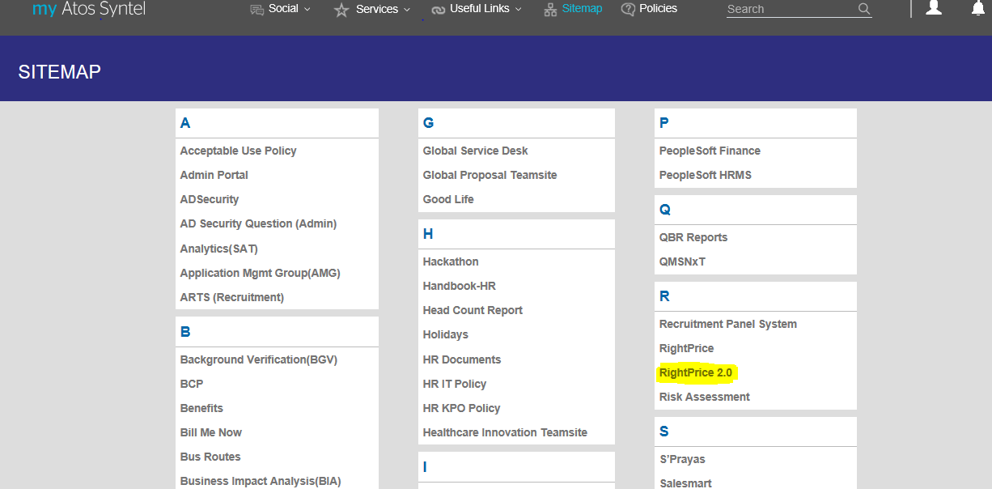
Delivery Log In
Right Price (RP) 2.0 is available on My Atos-Syntel platform. Below is the screen of RP 2.0 menu under Sitemap highlighted & is common screen in all users login.

Slide 7
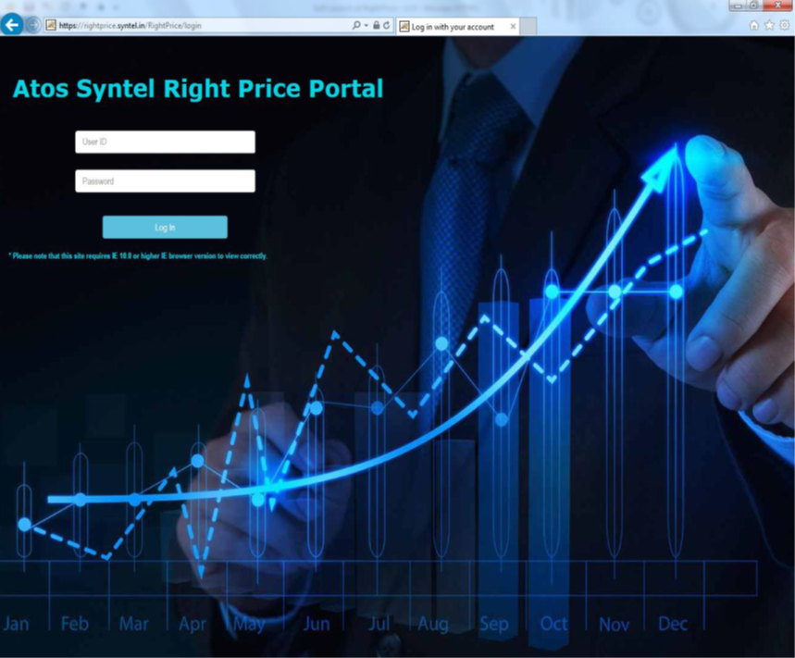
Delivery Log In
A link in myAtosSyntel is provided to access Right Price 2.0 portal. This link in turn will redirect the user to Login screen of the portal. User will have to enter valid Atos Syntel credentials to access the Portal. If user logins to Right Price portal by accessing the link in myAtosSyntel, irrespective of the login credentials entered in myAtosSyntel, user will still need to enter the credentials to access Right Price 2.0 portal.

Slide 8
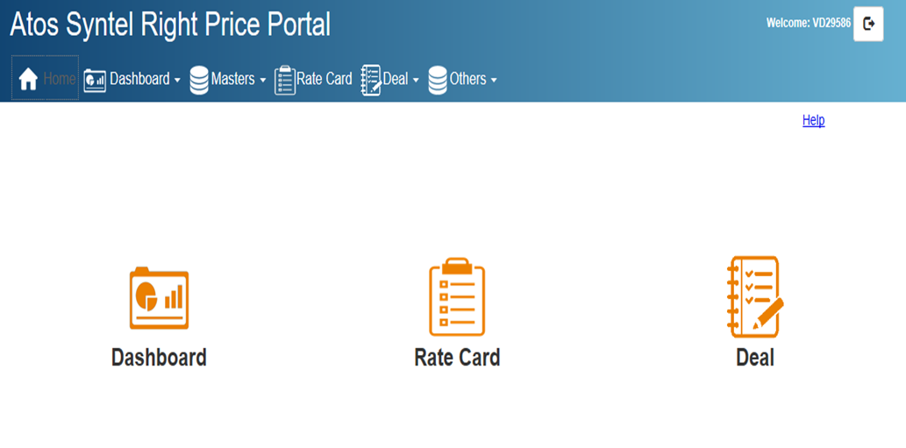
Creation of Rate card– Manual RC
Following screen appears on User Screen after login

Slide 9
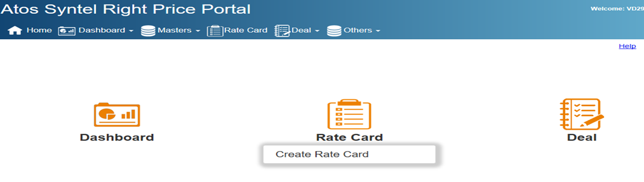
Rate card Screen
Step 1
Click on Rate Card.
Create New RC.

Slide 10
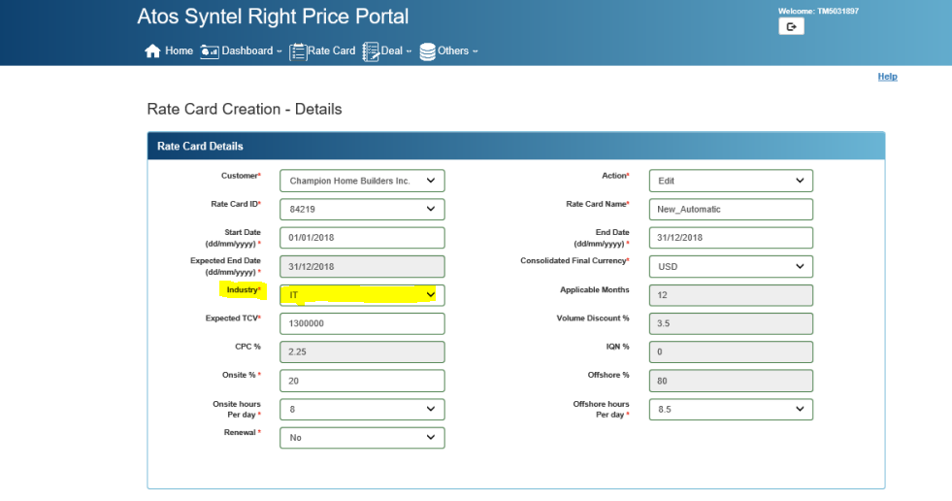
Rate card Creation Page
Step 2
Fill the details below.
Select IT/KPO in Industry tab as applicable

Slide 11
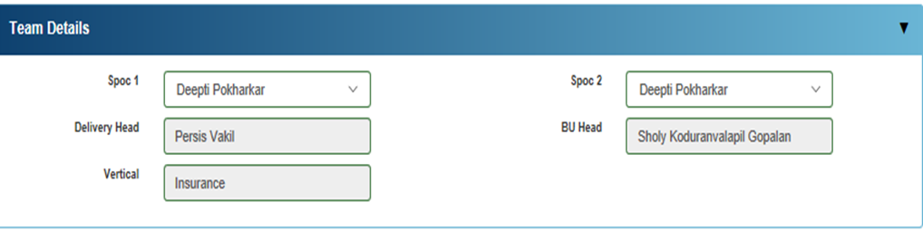
Rate card Delivery Team details
Step 3
In Team Details tab.
Update the Delivery Team details.

Slide 12
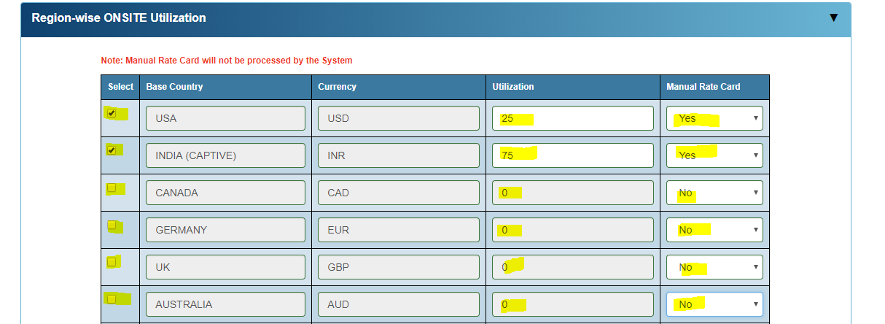
Rate card Utilization Page
Step 4
Select Base Country. Manual Rate card can be prepared for Multiple countries
Update Utilization percentage.
Select YES for Manual RC.

Slide 13
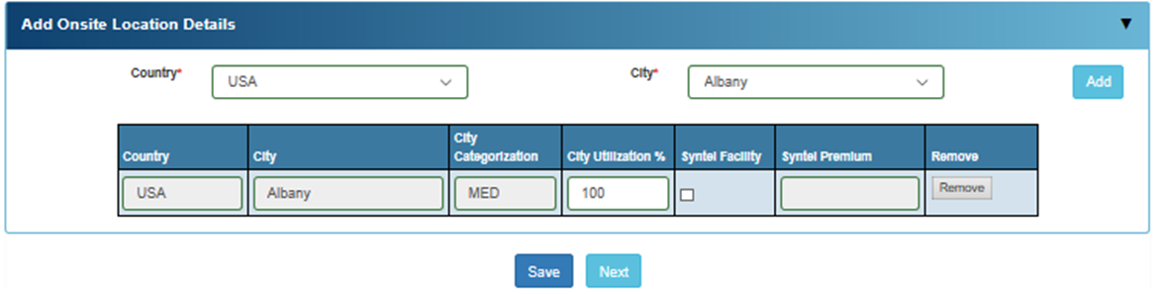
Rate card Location Detail
Step 5
Select Country & City.
Select Add.

Slide 14
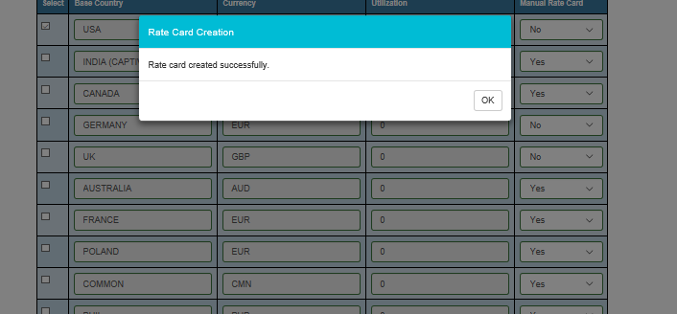
Rate card Location Detail submission
Step 6
After updating Onsite details.
Click Save.
Following Screen appears.

Slide 15
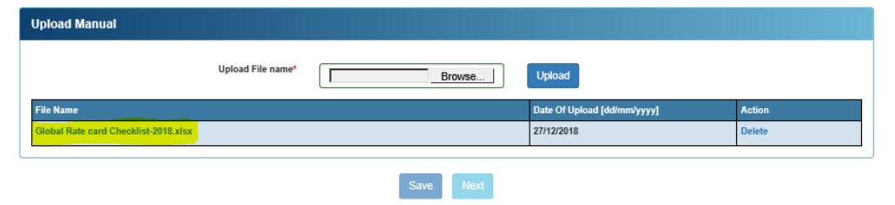
Upload Template for Checklist File.
Step 7
Browse and upload Rate card checklist file.
Click Save.
Press Submit to GFT.

Slide 16
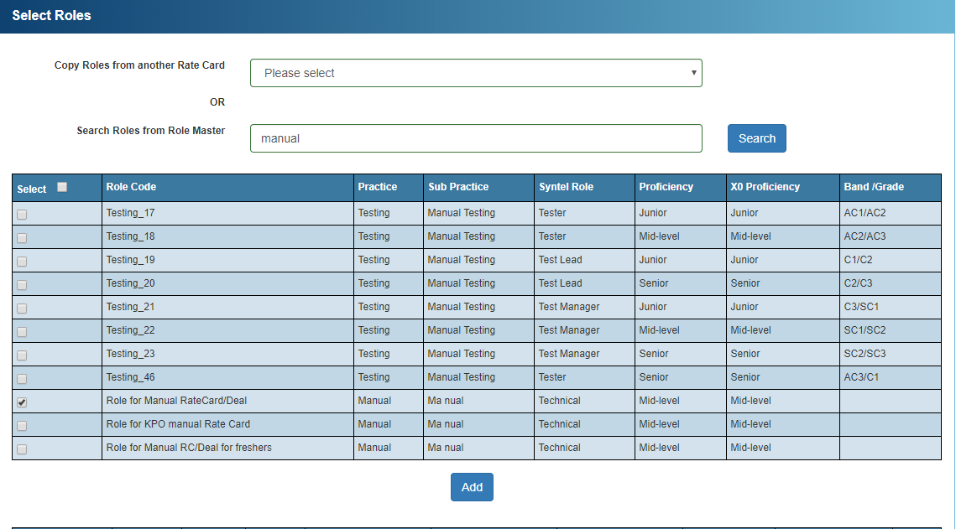
Rate card Creation & Role Selection
Step 8
After submission of Rate card checklist rate card will appear in GFT Queue.
Under Roles from Role Master type “Manual” & click “Search”.
Select “Role for Manual Rate Card”.
After selection Click “Add”.

Slide 17
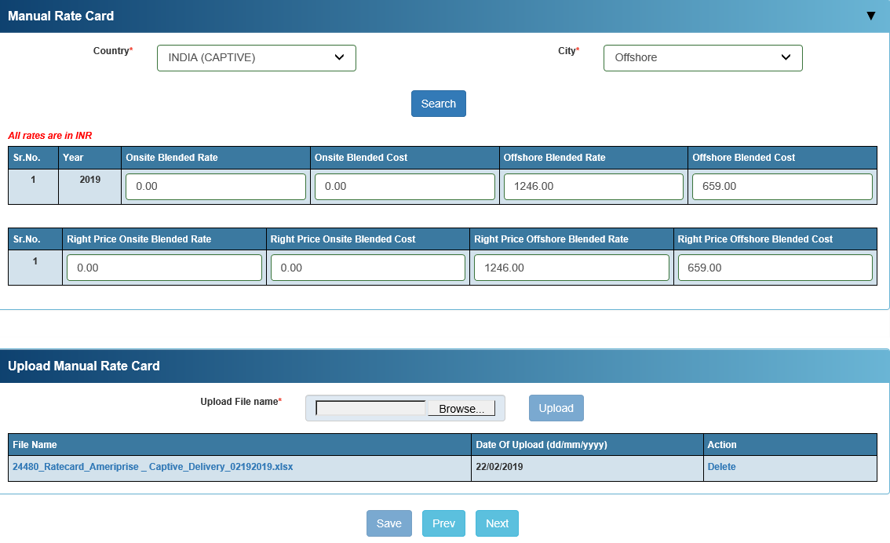
Manual RC file upload
Step 9
Select Country & City as applicable. If rate card is for Multi Country User have to select all Countries & City
Fill Onsite & Offshore Blended Rate & Cost as applicable for the respective countries & Click on Save
Upload Rate card file & Save

Slide 18
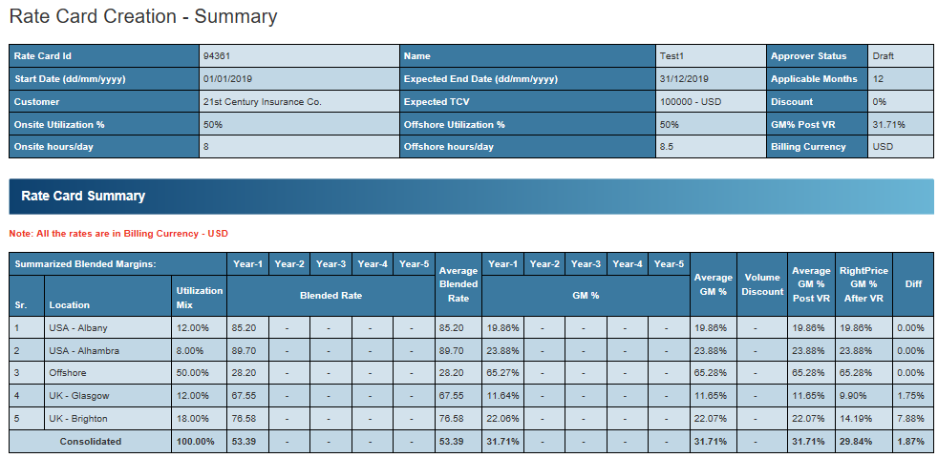
Rate card Summary
Step 10
Below screen display the Summary details Year wise & Country wise
User can view the Location wise GM & Consolidate GM & Click on Next

Slide 19
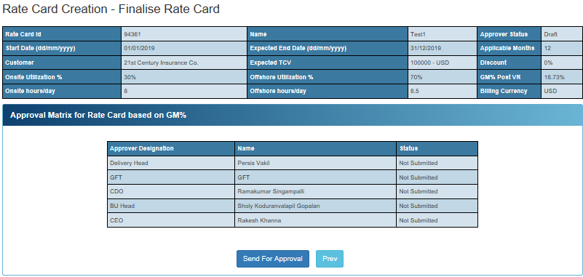
Finalize Rate Card
Step 11
Below screen displays the sequential flow of the approver matrix.
User needs to click on Send for Approval to initiate the approval flow
Based on approval matrix rate card will flow to next level of approval. All rate card has to be approved by BUH & CDO & where Gross GM is less then 35% it has to be approved by CEO

Slide 20
For more information please contact: T+ 33 1 98765432 F+ 33 1 88888888 M+ 33 6 44445678 firstname.lastname@atos.net

